Slide 1
Week 3: Conducting interdisciplinary research: An overview
INFT 4017

Slide 2
Australian Research Council
Interdisciplinary research breaks down traditional disciplinary boundaries to promote the cross-fertilization of ideas.
It is a key strategy for solving complex problems in science and society (from The Scientist.com).

Slide 3
Eureka Prize for Excellence in Research by an Interdisciplinary Team
The Eureka Prize rewards an Australian research partnership, group or team for a groundbreaking outcome that has involved collaboration and integration between researchers from two or more unrelated disciplines.
Professor Geoffrey Webb, WINNER 2017 Eureka Prize for Excellence in Data Science
https://www.youtube.com/watch?v=AN3y50_XXrs&feature=youtu.be

Slide 4
The value of interdisciplinary research (acknowledgement: Diesendorf & Rammelt, Opinion, 2012)
Most of the academic research at Australian universities is disciplinary based.
However, none of the biggest problems faced by human society (such as environmental destruction, resource depletion, poverty, disease, and social injustice) fits into a single academic discipline.

Slide 5
The members of the interdisciplinary team try to understand the strengths and limitations of the disciplinary contributions from all their fellow team members.

Slide 6
The focus is on the problem and its solutions, instead of the individual disciplinary perspectives and solutions.
Interdisciplinary research complements disciplinary research and adds value by integrating disciplinary and other knowledge.
It can address more comprehensively and effectively major environmental and social problems.

Slide 7
Vignettes – variety of interdisciplinarity (acknowledgement: Gabriele Bammer, ANU, Funding Interdisciplinary Research)
Historian who ‘borrows’ from sociology, anthropology, applied ethics
Collaboration between psychologist and economist (behavioural economics)
Team from physics, chemistry and engineering developing a new technology
Team from the natural and social sciences researching sustainability

Slide 8
Examples of interdisciplinary research
ARC Centre of Excellence in Population Ageing Research (Funding: $12.7 million over 7 years since 2016)
The Centre aims to establish Australia as a world leader in the field of population ageing research.
Through a unique combination of cross-disciplinary expertise drawn from Economics, Psychology, Sociology, Epidemiology, Actuarial Science, and Demography.
It will produce research that will transform thinking about population ageing, inform private and public sector policy and yield outcomes that improve the well-being of the aged and their social and economic environment.

Slide 9
Interdisciplinary research at UniSA
Socially Inclusive Employment Practices and Australian’s Cultural and Creative Industries
Investigators:
Prof Susan Luckman - CIL - Division of EASS Prof Ruth Rentschler - BUE - UniSA Business School Dr Heather Anderson - CIL - Division of EASS Dr Ruchi Sinha - BUE - UniSA Business School
External industry partners:
MEAA - Media, Entertainment Arts Alliance Australian Human Rights Commission, AMIA - The Digital Industry Association of Australia.
Youtube: https://www.youtube.com/watch?v=G55YIAXP4YA

Slide 10
Understanding brain activity during Web searching
(Shovon, Nandagopal, Du, et al. 2015)
Understanding brain activity during Web search is essential for better understanding of the cognitive demands imposed by the search system and search tasks.
Our study contributes to this understanding by combining disciplines of computing neuroengineering and information retrieval.
Specifically, we construct brain networks from EEG data using normalized transfer entropy (NTE) during three Web search task stages: query formulation, viewing of a search result list and reading each individual content page.

Slide 11
Previous studies have relied on inferential methods (such as eye tracking), how brain regions connect during effective Web searching, and which region acts as an information convergence region remain unknown.
Neuroimaging techniques such as EEG can, however, provide more direct measures of users’ cognitive activity and recent studies have also highlighted the potential of neuroscience to contribute in interactive information retrieval.

Slide 12
Our study aims to capture the dynamic interactions between neuronal elements of the human brain during Web search task stages by constructing functional brain networks (FBNs) from time series observations of EEG signals using normalized transfer entropy (NTE).

Slide 13
Methods:
Participants
Ten (seven males, three females; age range 22-59) academic/professional staff and students participated in this study. The experiments were conducted at the Cognitive Neuroengineering Laboratory, UniSA.
Cognitive Tasks and EEG Data Acquisitions
Continuous EEG data were collected during three different brain states: eyes open (baseline), visual search and Web search interaction conditions.
Users’ Web search interaction sequences (e.g. mouse and keyboard activity; visited and bookmarked URLs) were recorded using Camtasia Studio software.

Slide 14
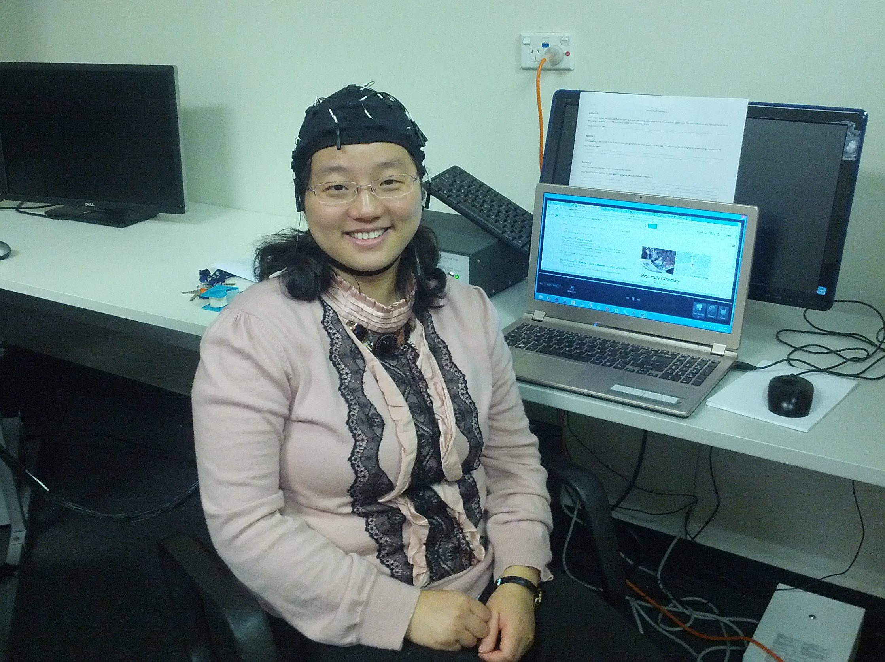
Notes:
User experiment (a participant attending web search tasks and the brain activity was being captured as EEG data)
each participant was fitted with an appropriate sized 32 channels Quikcap.

Slide 15
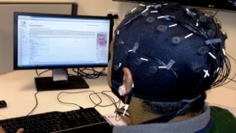



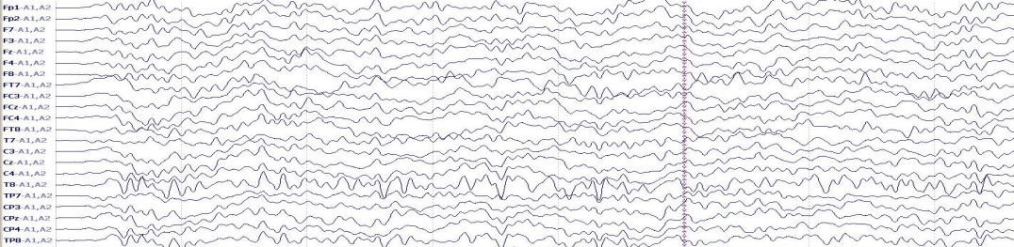
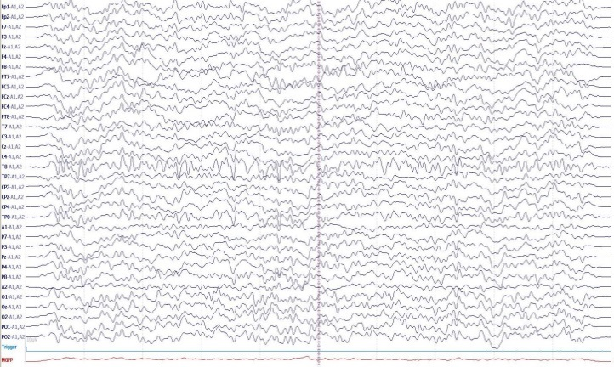
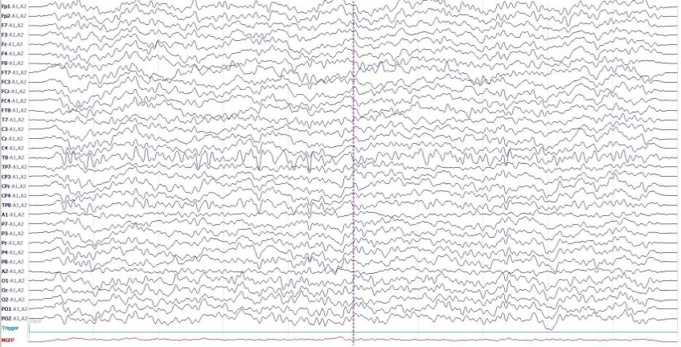
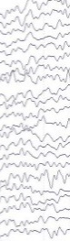
Q­_{start}
L_{start}
Q­_{end}
L­_{end}
EEG Data Acquisition
C­_{start}
C­_{end}
Pre-processing
Pre-processed EEG Signals
Pre-processed EEG Signals
2 sec epoch
Graph Database Construction during EOP and VS
Creating 2 sec epoch
Creating 2 sec averaged epoch
Computation of NTE
Graph Database during Q
(NTE)
Graph Database during L (NTE)
Graph Database during C (NTE)
2s averaged epoch (Q)
Visualization
(Topoplot)
Complex Network Analysis
Connectivity Density
Degree Centrality
Notes:
Figure. Transfer Entropy Analysis Framework for Web Search (TEAF-WS)
This figure illustrate the data, information processing and associated computational steps.

Slide 16
Findings
We identified that the cognitive activities during the three stages of Web searching are different, with various brain areas becoming more active during the three Web search task stages.
Query formulation generated higher interaction between cortical regions than viewing a result list or reading a content page.
These findings will have implications for the improvement of Web search engines and search interfaces.

Slide 17
References
http://www.arc.gov.au/sites/default/files/filedepot/Public/Policy%20&%20Strategy/International/GRC/Professor%20Bammer%20Dec%202015.pdf
https://www.science.unsw.edu.au/news/opinion-value-interdisciplinary-research
http://www.the-scientist.com/?articles.view/articleNo/46442/title/Interdisciplinary-Research-Attracts-Less-Funding/
Shovon, M.H.I. , Nandagopal, D., Du, J. T. et al. (2015). Cognitive activity during Web search. In Proceedings of the 38th ACM International Conference on Research and Development in Information Retrieval (ACM SIGIR 2015). (pp. 967-970). New York: ACM.

